Slide 1
Hudson Bay Resources AS
An Investment Case 2018:

Slide 2
Company overview
Established in 1995 in Norway.
A gold exploration company focused on defining a potentially significant resource in Ghana.
Presence in Accra, Ghana since 2008. Head office in Oslo Norway.
Experienced senior staff and geologists.

Slide 3
Board and management
Chairman and President Torgeir Vikenes.
Investor, founder and manager with a masters degree in
economics and outstanding performance as adviser to companies.
Board members:
Jan-Øyvind Lorgen is an investor focusing on the mineral business. He
works as a general practitioner in Akershus.
Arnfinn Berg is an investor and manager with international experience.
He is a specialist in advertising and business organization.
Stig Christoffer Solli is an investor focusing on the oil, gas and
mining industry. He is an experienced board member from a number
of companies.

Slide 4
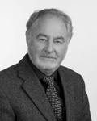
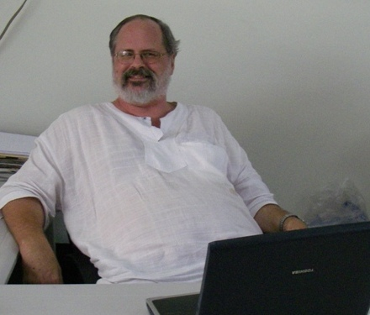
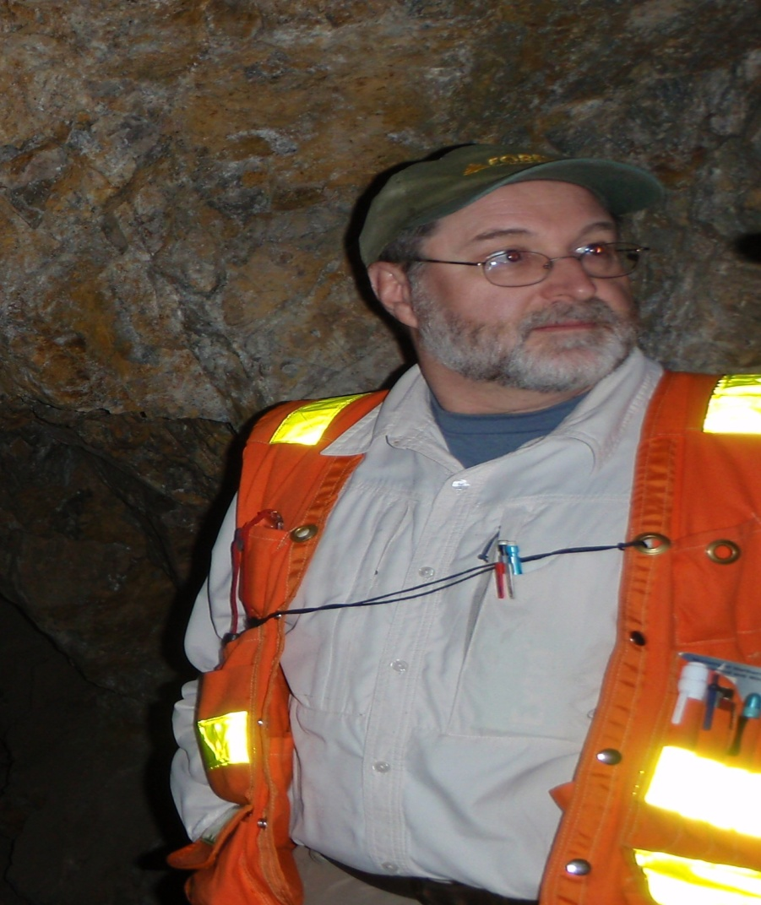
Senior geologists
M. Sc. Boye Flood
One of Norways most experienced geologists working on gold exploration
in Australia, Africa and in the Nordic Area.
M. Sc Neil Macfarlane
He has 30 years experience in exploration geology, underground gold mining and reserve definition. Chief geologist and manager of international companies.
M. Sc., P. Geo. Paul Chamois
He has over 25 years of senior exploration and management experience from Canada, USA, Mexico, Sweden, and Africa.
Notes:
4

Slide 5
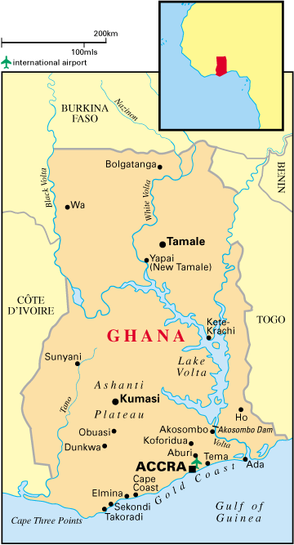
Ghana – West Africa
License

Slide 6
Ghana – facts and figurs
Population is estimated to + 27 mill. people.
Accra, the capitol is speculated to have more than 5 mill. residences.
Area is 238.537 sq km..
Population density is 91 people per sq km.
Economic figures:
GDP 37 billion USD (2015),
GDP – per capita 1.500,- USD
Exports 5,4 billion USD
GDP per sector; Agriculture 37,3 %, Industry 25,3 % and
Services 37,5 %
Main exports gold, cocoa, timber, bauxite and diamonds.
Notes:
6

Slide 7
Gold production in Ghana
Production in 2016 ended at 4,1 million ounces of gold.
To date, more than 140 million ounces of gold has been discovered.
Totaling 2,3 billion USD in yearly sales.
Ghana is the second largest gold producer in Africa and number 10 worldwide .
The Ashanti Gold Belt has alone produced 40 million ounces of gold.
International money transactions works well.
.

Slide 8
Mining companies in Ghana
Red Back Mining Inc. large scale mining operation target 170.000 ounces of gold in 2009. The mine is 60 km north of our regional license. Kinross bought Red Back Mining in 2010 for $ 7 billion and is now operating the mine.
Perseus Mining Ltd of Australia has produced 176.000 ounces in 2017.
AngloGold Ashanti Ltd operates mines in Ghana, Obuassi, that has reserves mounting to 3,6 million ounces of gold in 2017.
Newmont Inc. is another mining company in Ghana with 5,6 million ounces last year.
Golden Star Resources Ltd operates mines near Prestea and produced 267.575 ounces in 2017.

Slide 9
Mining license regime
Reconnaissance License covers the acquisition of properties
and the first stages of exploration.
Prospecting License gives the right to drill and excavate.
Mining Lease gives the right to extract minerals.
Small scale mining license is mainly for the local population.
Notes:
9

Slide 10
Afro Scandic Ltd. (Ghana subsidiary of Hudson Bay Resources AS earlier Hudson Ghana Gold Ltd.)
Main business is to aquire land, licenses and mining rights for developement through exploration, of gold resources.
Owns a regional reconnaissance license within the Asankrangwa gold belt.
The license is 137,76 sq km. The exploration work started in 2008 and continued through 2017 with alluvial test production af gold.

Slide 11
The license:
The reconnaissance license was granted in February 2008 and is a 137,76 sq km property with high potential.
Geologists from Scott Wilson(Canada) did first exploration work.
Gold was found in 36 % of all top soil samples.
Samples from river sediments and soil was combined with auger drilling.
Encouraging results gave a recommendation from geologists to continue exploration and development.
A gold mineralization has been identified and alluvial test production of gold resulted in nearly 500 gr of gold per week in 2017.
Target is to increase gold production and invest the earnings in exploration work to be able to define a potentially significant gold resource.

Slide 12
First round river sediment sampling
12
Notes:
12

Slide 13
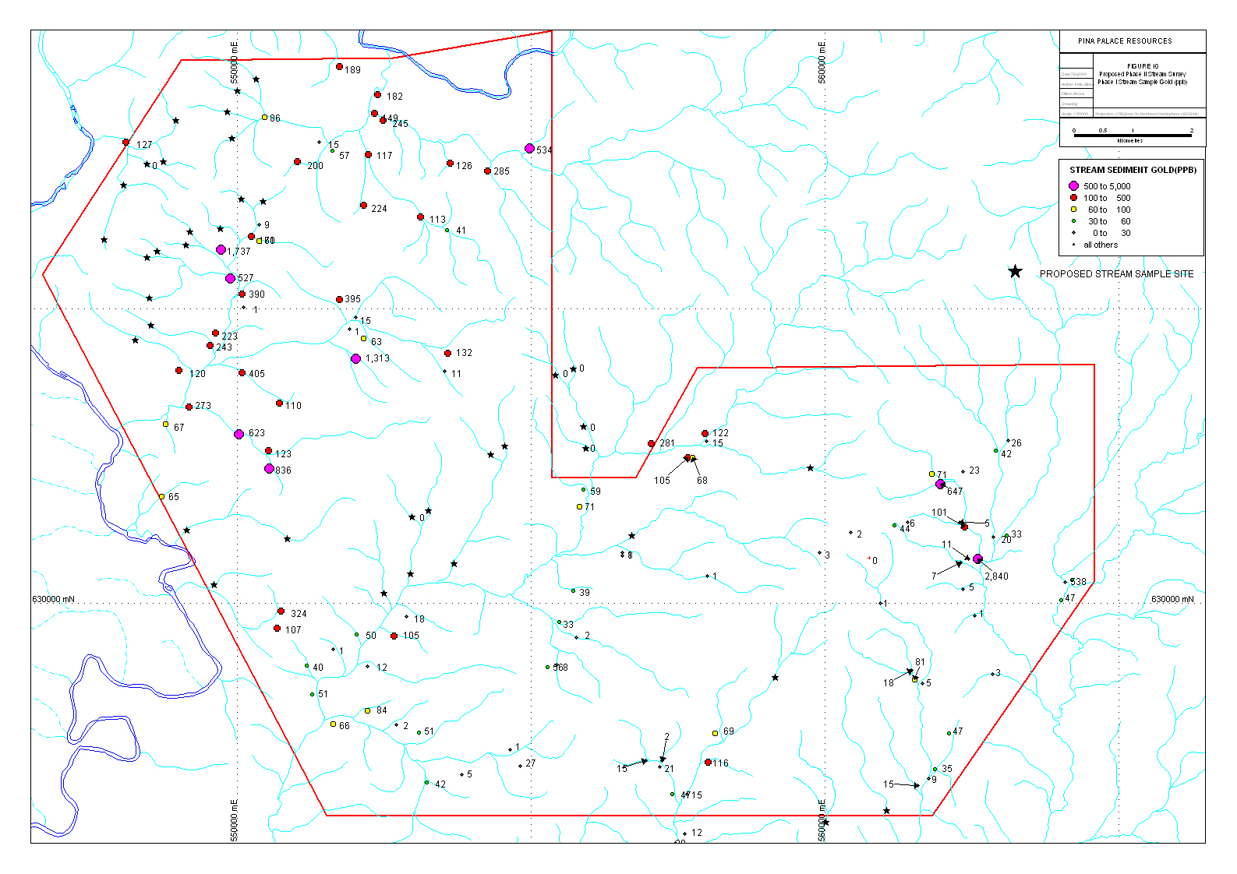
Close up of river sediment sampling
Map shows place of river
sediment sample collection
and results in ppb.
13
Notes:
13

Slide 14
First round soil sampling
14
Notes:
14

Slide 15
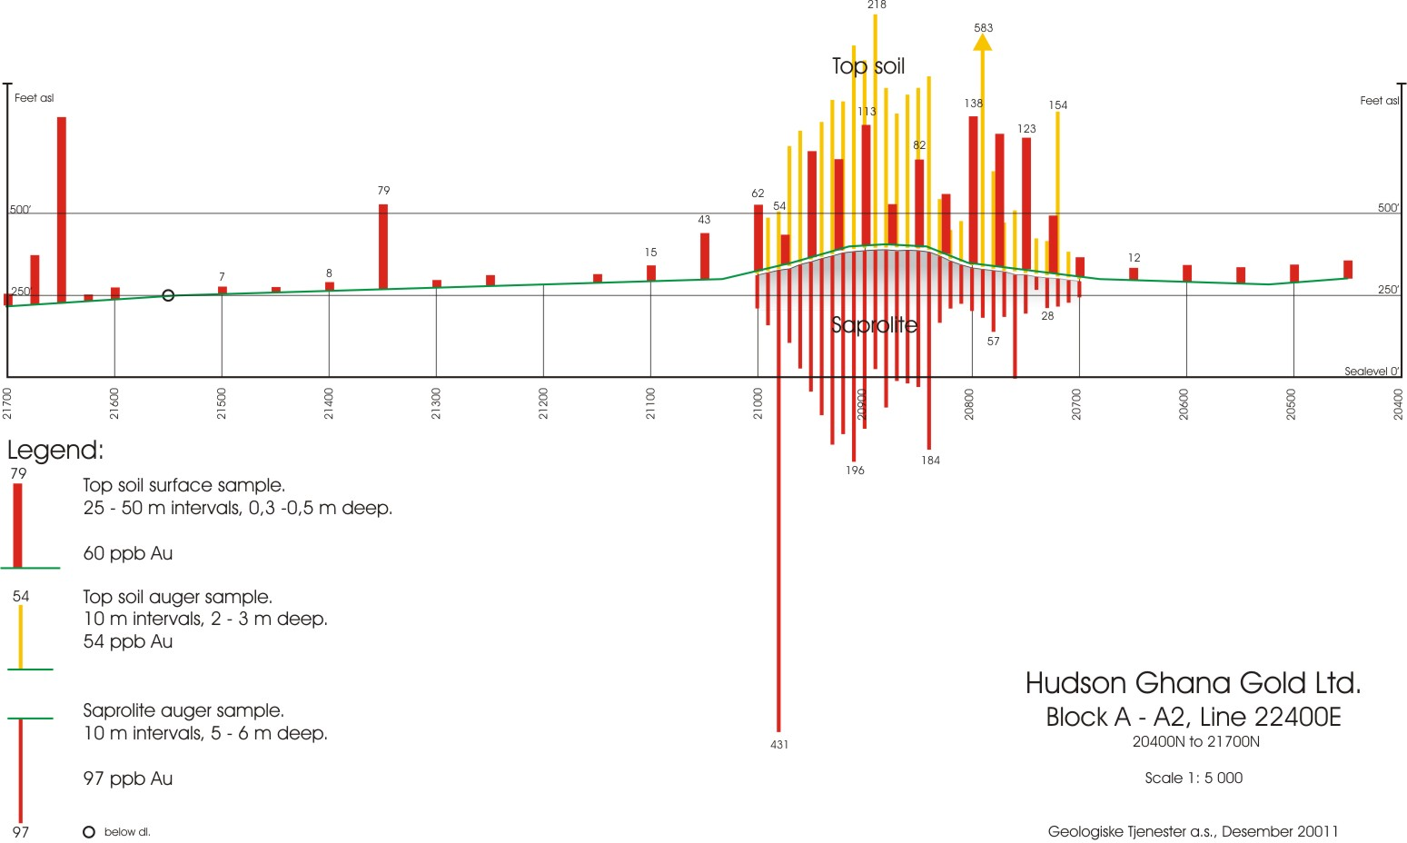
Auger drilling and soil samples 1
15
Notes:
15

Slide 16
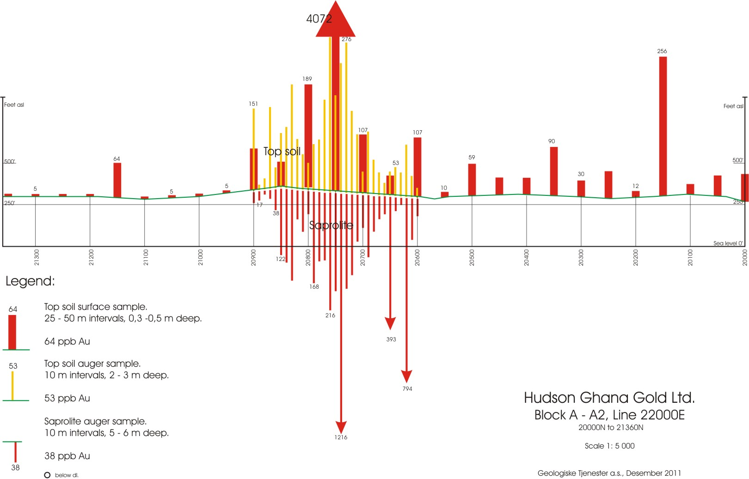
Auger drilling and soil samples 3
16
Notes:
16

Slide 17
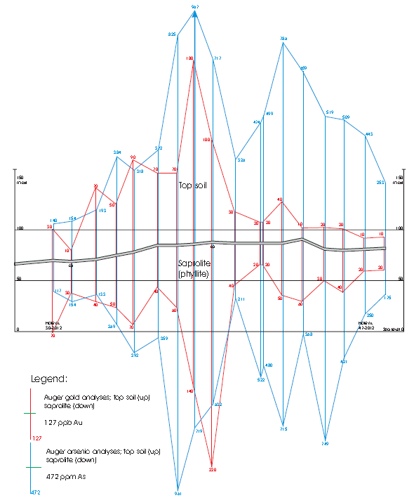

Slide 18
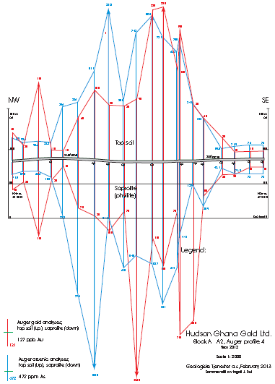

Slide 19
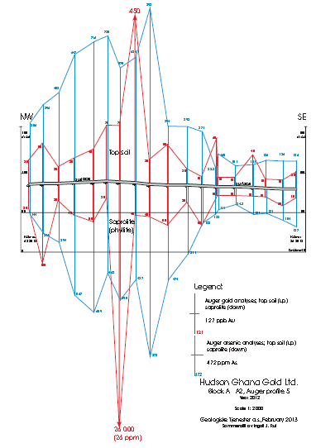

Slide 20
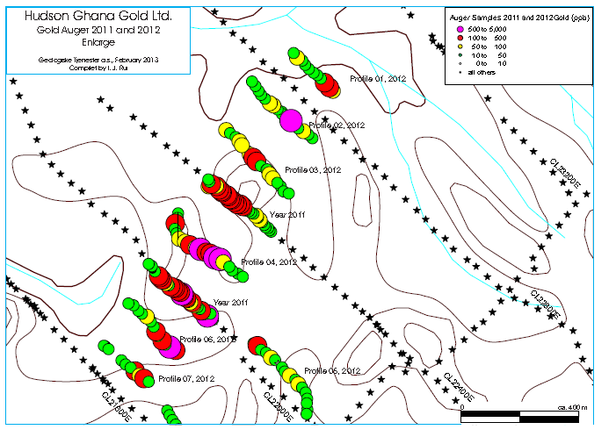

Slide 21
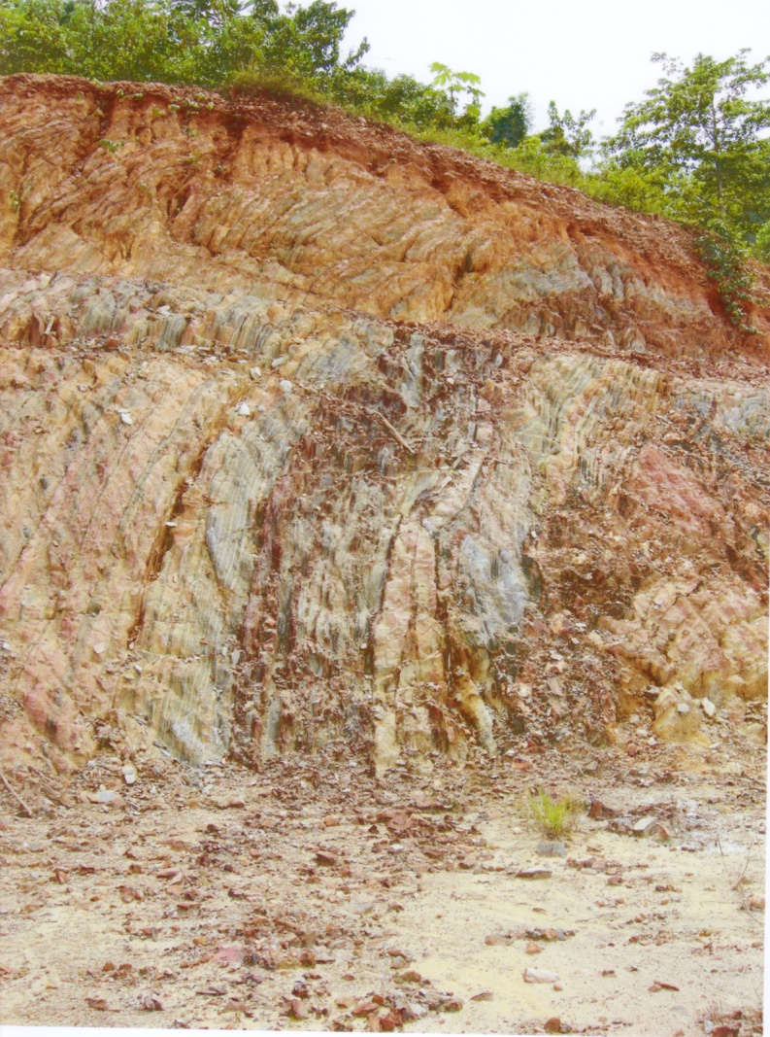
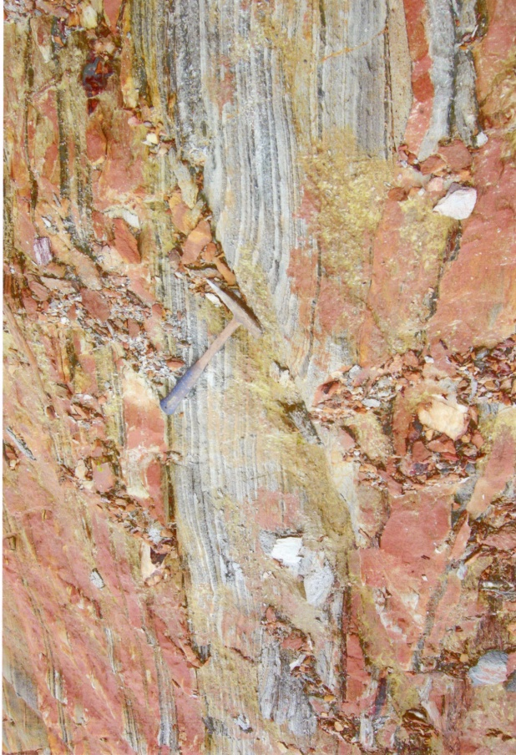
Volcanic trends revealed
Notes:
21

Slide 22
Exploration results
First three phases of exploration shows high numbers of gold in both stream sediments and soil samples.
Stream sediments results up to 2.840 ppb Au.
Soil samples results up to 5.850 ppb Au.
Results from exploration shows three separate anomalies in our first two blocks named Block A1 and A2.
Auger drilling showed a gold mineralization in the ground.
Recommendation from all three geologist to continue based on the encouraging results.
Notes:
22

Slide 23
2018-2020 exploration program
Apply for an extended exploration license.
Fly-over for complete geomagnetic survey will be done.
Alluvial test production will be increased with new equipment installed and more people hired.
Diamond drilling or similar techniques will be used to establish resource estimates accepted by the mining industry.
Notes:
23

Slide 24
The investment opportunity 2018!
To allow further development of our regional license we invite investors to use the opportunity to buy shares in our company.
We are offering shares for up to eur 9. Mill. priced at 1 NOK per share for a limited period of time.
Combined with the continued high gold price, this is a “golden” opportunity for investors.

Slide 25
This is what you do to invest:
Download the application form from our homepage and fill in your information. Return it to the e-mail listed.
If questions, please use the contact information on our homepage: www.hubr.no
Thank you for your attention!

